Slide 1

Prefix Operations and Tries
A workload-centered analysis of tries, applying data structures to optimize tries, and designing prefix operation algorithms.
Kevin Lin, with thanks to many others.
Notes:
Ask questions anonymously on Piazza. Look for the pinned Lecture Questions thread.

Slide 2
Feedback from the Reading Quiz
Searching for a string of length L in a hash table is O(NL).
“Worst case” scenario where every string collides into the same bin, and each string only differs on the last character. (Doesn’t really happen in practice.)
Say our search string is at the end of the list. Need to call equals on every string.
Each equals call needs to compare the first chars, the second chars, the third chars…
Relationship between DataIndexedCharMaps, hashing, and tries?
It takes time to compare two strings!
Tries optimize for storing strings char-by-char.
Notes:
The reading introduced us to a missing component of our runtime analysis. Specialized data structures, like DataIndexedCharMap, can be simpler and faster than more general but also more complex data structures like hash tables.

Slide 3
Tries: A Specialized Data Structure
Tries are a character-by-character set-of-strings implementation.
a
s
sad
0
1
2
3
sad
sam
awls
w
a
awls
same
a
sap
l
d
m
p
a
sam
sap
same
s
e
Binary Search Tree
Hash Table
Trie

Slide 4
Searching in Tries
contains(“sam”): true, blue. hit.
contains(“sa”): false, white. miss.
contains(“a”): true, blue. hit.
contains(“saq”): false, fell off. miss.
Two ways to have a search miss.
If the final node is white.
If we fall off the tree.
a
s
w
a
l
d
m
p
s
e

Slide 5
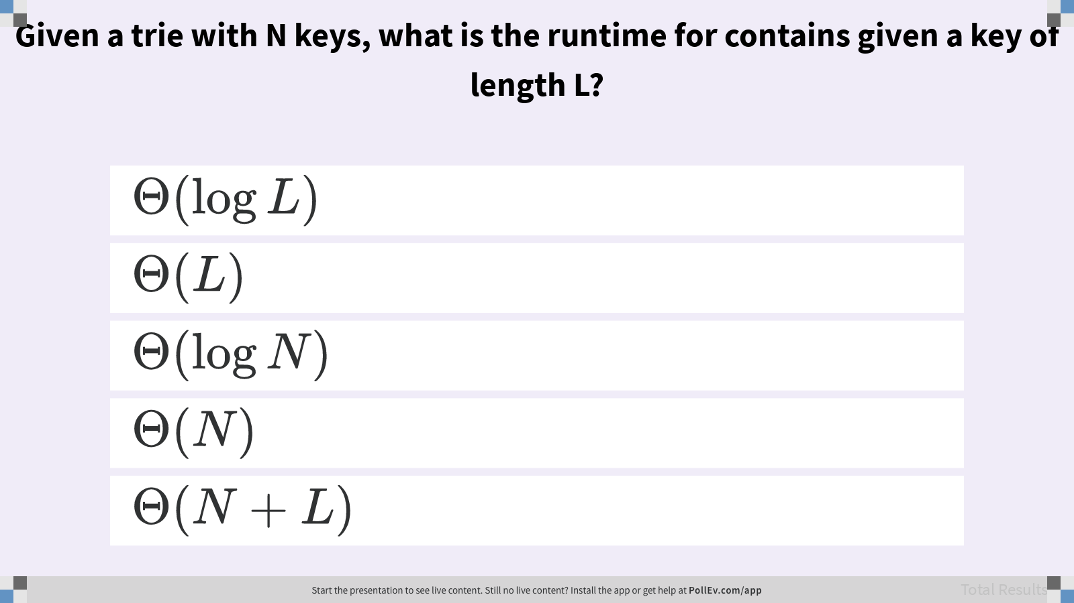
Given a trie with N keys, what is the runtime for contains(key) for a key of length L?
Notes:
Assuming the key is in the trie.

Slide 6
Trie: Design 1
public class TrieSet {
private static final int R = 128; // ASCII
private Node root;
private static class Node {
private char ch;
private boolean isKey;
private DataIndexedCharMap<Node> next;
private Node(char c, boolean b, int R) {
ch = c; isKey = b;
next = new DataIndexedCharMap<Node>(R);
}
}
}
a
s
w
a
l
d
m
p
s
e
Notes:
?: What’s inefficient about this implementation?

Slide 7
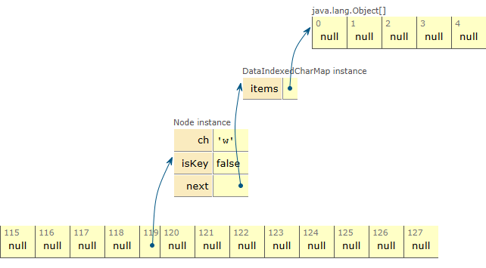
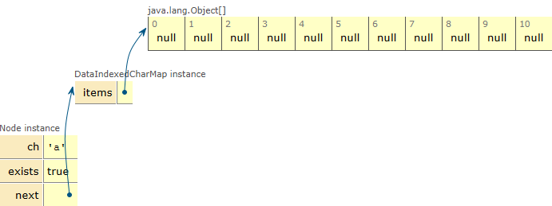
Trie Node Implementation
private static class Node {
private char ch;
private boolean isKey;
private DataIndexedCharMap<Node> next;
private Node(char c, boolean b, int R) {
ch = c; isKey = b;
next = new DataIndexedCharMap<Node>(R);
}
}
...
a
128 links, mostly null
w

Slide 8
Trie Node Implementation
private static class Node {
private char ch;
private boolean isKey;
private DataIndexedCharMap<Node> next;
private Node(char c, boolean b, int R) {
ch = c; isKey = b;
next = new DataIndexedCharMap<Node>(R);
}
}
a
a
w
128 links, mostly null
w
...
w

Slide 9
Trie: Design 1
public class TrieSet {
private static final int R = 128; // ASCII
private Node root;
private static class Node {
private char ch;
private boolean isKey;
private DataIndexedCharMap<Node> next;
private Node(char c, boolean b, int R) {
ch = c; isKey = b;
next = new DataIndexedCharMap<Node>(R);
}
}
}
a
s
a
...
s
w
...
a
w
...
a
...
l
...
d
l
...
d
...
...
Notes:
?: What information is redundant in this data structure?

Slide 10
Trie: Design 1.5
public class TrieSet {
private static final int R = 128; // ASCII
private Node root;
private static class Node {
private char ch;
private boolean isKey;
private DataIndexedCharMap<Node> next;
private Node(char c, boolean b, int R) {
ch = c; isKey = b;
next = new DataIndexedCharMap<Node>(R);
}
}
}
a
s
...
w
...
a
...
...
l
...
d
...
...
...
Notes:
We can remove the character ch from the node because we’ll know which character we’re on when we index into the DataIndexedCharMap next.

Slide 11
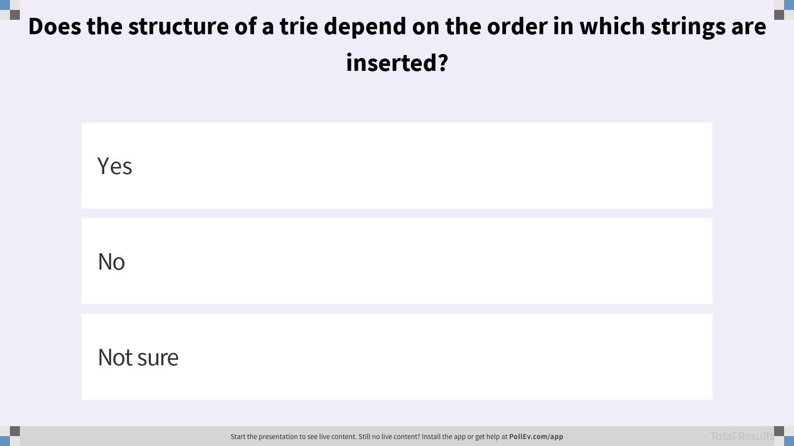
Does the structure of a trie depend on the order in which strings are inserted?

Slide 12
Trie Runtime
When our keys are strings, Tries give us slightly better performance on contains and add.
However, DataIndexedCharMap wastes a ton of memory storing R links per node.
Typical runtime when treating length of keys as a constant.
 | Key type | contains(x) | add(x)
Balanced BST | comparable | Θ(log N) | Θ(log N)
Hash Table | hashable | Θ(1)* | Θ(1)*†
Data-indexed array | char | Θ(1) | Θ(1)
Trie: Design 1.5 | string | Θ(1) | Θ(1)
* : Assuming items are evenly spread.
† : Indicates “on average”.
Notes:
?: How might we address the memory usage problem? What ideas can we borrow from other data structures?

Slide 13
Dealing with Sparsity

Slide 14
v1.5: DataIndexedCharMap
isKey = false
… | 97 | 98 | 99 | 100 | …
isKey = false
isKey = true
a
c
… | 97 | 98 | 99 | 100 | …
… | 97 | 98 | 99 | 100 | …
d
isKey = true
Abstract Trie
… | 97 | 98 | 99 | 100 | …

Slide 15
v2.0: Hash-Table-Based Trie
isKey = false
0
1
2
3
a
c
isKey = false
isKey = true
(c)
0
1
2
3
d
0
1
2
3
a
c
d
(ad)
isKey = true
0
1
2
3
Abstract Trie

Slide 16
v3.0: BST-Based Trie
isKey = false
‘a’
Each trie node keeps track of its own BST
‘c’
isKey = false
isKey = true
(c)
a
c
‘d’
d
(ad)
isKey = true
Abstract Trie

Slide 17
v4.0: Ternary Search Trie (TST)
Integrate internal BSTs into main structure.
a
a
c
d
c
d
Abstract Trie
Ternary Search Trie
Notes:
?: How do you look up the string “ad” in the ternary search trie? The string “c”?
?: How is the ternary search trie different from the abstract trie? From the BST-based trie?

Slide 18
Which value is associated with the key “CAC”?
Q
A
C
1
C
A
G
G
G
C
5
2
C
3
C
C
6
G
C
4
Tries in COS 226 (Sedgewick, Wayne/Princeton)
Notes:
If you’re not sure where to start, look back at the previous example.
Q1: Which value is associated with the key “CAC”?

Slide 19
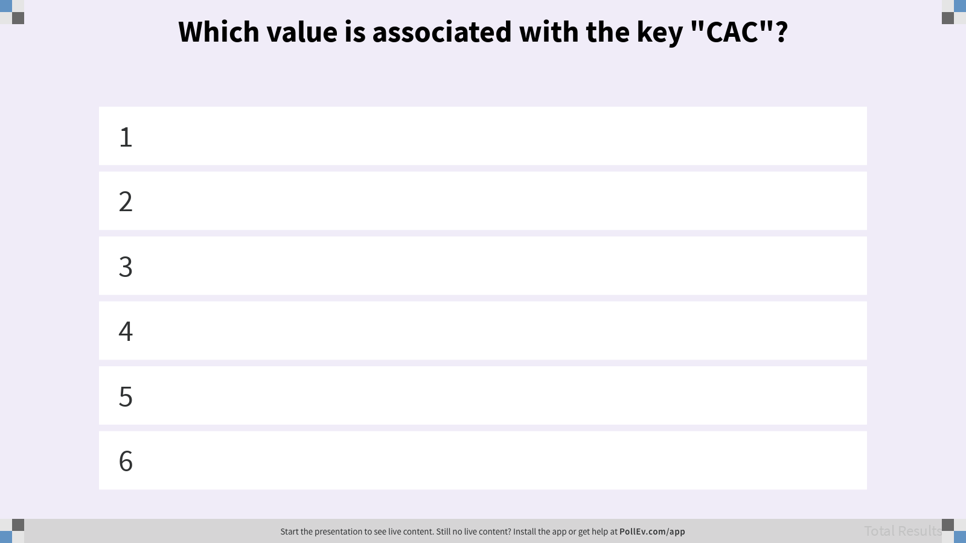
Which value is associated with the key “CAC”?

Slide 20
Search in a TST
Follow links corresponding to each character in the key.
If less, take left link; if greater, take right link.
If equal, take the middle link and move to the next key character.
Search hit. Final node is blue (isKey == true).
Search miss. Reach a null link or final node is white (isKey == false).
Tries in COS 226 (Sedgewick, Wayne/Princeton)

Slide 21
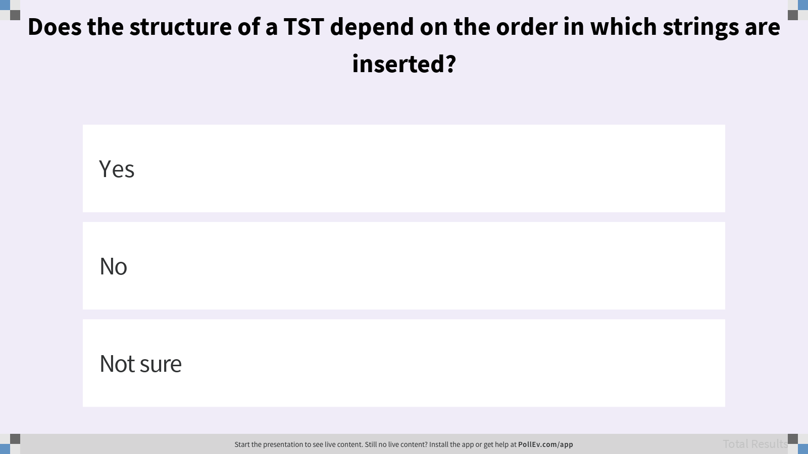
Does the structure of a TST depend on the order in which strings are inserted?

Slide 22
Prefix Operations
Notes:
Unfortunately, since TSTs behave like (unbalanced) binary search trees, the runtime depends on the insertion order. The exact runtime of TSTs fall outside of the scope of this course, but it’s useful to know that they’re about as fast as hash tables in practice, and can be made faster with some simple optimizations.

Slide 23
String-Specific Operations
Theoretical asymptotic speed improvement is nice.
But the main appeal of tries is their efficient prefix matching.
Prefix match. keysWithPrefix("sa")
Longest prefix. longestPrefixOf("sample")
In this section, we’ll use the abstract trie representation.
a
s
w
a
l
d
m
p
s
e
Abstract Trie
Notes:
All of this also applies to any other trie representation.

Slide 24
Collecting Trie Keys
Q
Describe in English an algorithm to collect all the keys in a trie.
collect(): ["a","awls","sad","sam","same","sap"]
Create an empty list of results x.
For character c in root.next.keys():
Call colHelp(c, x, root.next.get(c)).
Return x.
colHelp(String s, List<String> x, Node n)
???
a
s
w
a
l
d
m
p
s
e
Abstract Trie
Notes:
Q1: Describe in English an algorithm to collect all the keys in a trie.

Slide 25
Collecting Trie Keys
A
Describe in English an algorithm to collect all the keys in a trie.
collect(): ["a","awls","sad","sam","same","sap"]
Create an empty list of results x.
For character c in root.next.keys():
Call colHelp(c, x, root.next.get(c)).
Return x.
colHelp(String s, List<String> x, Node n)
If n.isKey, then x.add(s).
For character c in n.next.keys():
Call colHelp(s + c, x, n.next.get(c)).
a
s
w
a
l
d
m
p
s
e
Abstract Trie

Slide 26
Collecting Trie Keys
collect(): []
collect(): [ "a", ]
collect(): [ "a", "awls", ]
a
s
colHelp("a", x, )
w
a
colHelp("aw", x, )
l
d
m
p
colHelp("awl", x, )
s
e
colHelp("awls", x, )
colHelp(String s, List<String> x, Node n)
If n.isKey, then x.add(s).
For character c in n.next.keys():
Call colHelp(s + c, x, n.next.get(c)).
Abstract Trie

Slide 27
Collecting Trie Keys
collect(): [ "a", "awls", "sad", "sam", "same", "sap" ]
a
s
w
a
l
d
m
p
s
e
colHelp(String s, List<String> x, Node n)
If n.isKey, then x.add(s).
For character c in n.next.keys():
Call colHelp(s + c, x, n.next.get(c)).
Abstract Trie

Slide 28
Prefix Operations with Tries
Q
Describe in English an algorithm for keysWithPrefix.
keysWithPrefix("sa"): ["sad","sam","same","sap"]
a
s
w
a
l
d
m
p
s
e
Abstract Trie
Notes:
Q1: Describe in English an algorithm for keysWithPrefix.

Slide 29
Prefix Operations with Tries
A
Describe in English an algorithm for keysWithPrefix.
keysWithPrefix("sa"): ["sad","sam","same","sap"]
Find the node α corresponding to the string (in pink).
Create an empty list x.
For character c in α.next.keys():
Call colHelp("sa" + c, x, α.next.get(c)).
a
s
w
a
l
d
m
p
s
e
Abstract Trie

Slide 30

Extra: Autocomplete with Tries
Autocomplete should return the most relevant results.
One way: a Trie-based Map<String, Relevance>.
When a user types in a string "hello",
Call keysWithPrefix("hello").
Return the 10 strings with the highest relevance.

Slide 31
Top-3 Matches for "s"
Q
b
s
Call keysWithPrefix("s").
sad, smog, spit, spite, spy
Return the 3 keys with highest value.
spit, spite, sad
This algorithm is slow. Why?
u
a
m
p
c
12
i
d
o
y
7
10
g
t
k
5
15
e
20
Abstract Trie
Notes:
Q1: This algorithm is slow. Why?

Slide 32
Improving Autocomplete
value = None
best = 20
None
20
Very short queries, e.g. "s", will require checking billions of results.
But we only need to keep the top 10.
Prune the search space. Each node stores its own relevance as well as the max relevance of its descendents.
None
10
b
s
None
12
None
10
a
None
5
None
20
u
m
p
None
10
12
12
None
20
c
d
None
5
i
7
7
o
y
10
10
5
5
15
20
k
g
t
20
20
e
Notes:
Challenge: design an algorithm that can collect the top K results from a trie containing N total results. Assume K can also be very large.

Slide 33
Summary
When your key is a string, you can use a Trie.
Typically better real-world performance than hash table or search tree.
Need to decide on a mapping from letter to node. Ternary Search Trie is an elegant solution.
Most importantly, tries enable efficient prefix operations like keysWithPrefix.
Optimal implementation of autocomplete involves further optimizations!
Bottom line: Data structures interact in beautiful and important ways!

